Slide 1
Intrusion Detection System using ML&DL Techniques
Minor Project – B.Tech (IoT & Intelligent Systems)
Presented By:
Aayush Bindal (229311202)
Atharva Deshmukh (229311049)
Under the Guidance of:
Dr. Bhawana Sharma

Slide 2

Problem Statement
Intrusion Detection Systems (IDS) play a crucial role in securing computer networks by identifying malicious activities and unauthorized access attempts. Traditional rule-based IDS struggle to keep up with sophisticated cyber threats, as they rely on predefined signatures that fail against novel attacks.
The goal of this project is to develop an ML/DL-based Intrusion Detection System (IDS) using the NSL-KDD dataset to classify network traffic as normal or malicious. The system should be capable of detecting various types of cyberattacks, including DoS (Denial-of-Service), probe attacks, U2R (User-to-Root), and R2L (Remote-to-Local) intrusions.

Slide 3
Project Journey
Phase 1
January 3-7
Guide Allotment
Phase 2
January 7-13
Team Selection & Topic Selection
Phase 3
January 14-15
Topic Confirmation & Guidance from Mentor
Phase 4
January 16-20
Exploration of suggested datasets & related research papers
Phase 5
January 21-31
Project methodology Selection
Phase 6
February 1-12
Learning about ML & DL techniques
Phase 7
February 12-24
Preliminary testing of dataset
Phase 8
February 26-28
Applying Basic ML techniques on dataset
Phase 9
March 1- till date
Applying DL techniques
& research on project

Slide 4
Methodology
Data Collection
Collection from NSL-KDD Dataset
Data Preprocessing
Data Cleaning
Class Imbalance Handling
ML & DL
KDDTrain+
KDDTest+
Feature Engineering
Feature Scaling
Feature Selection
Model Training to establish baseline performance
Model Evaluation
Model Optimization
Model Deployement
Convert trained model
Integrate in realtime network monitoring system

Slide 5
Process: Dataset
The NSL-KDD dataset is an improved version of the KDD Cup 1999 dataset, widely used for Intrusion Detection System (IDS) research. It is designed to address the limitations of the original KDD'99 dataset, which had issues like redundant records and imbalanced attack classes.
The dataset has 41 input features, categorized into three types:
Feature Type | Description | Examples
Basic Features | Basic connection properties | duration, protocol_type, src_bytes
Content Features | Traffic-related content | num_failed_logins, is_guest_login
Traffic Features | Time-based traffic statistics | count, srv_count, dst_host_count

Slide 6
Process: Preprocessing
1. Feature Scaling (Normalization):
RobustScaler is used to scale numerical features, making the dataset less sensitive to outliers.
Function Scaling(df_num, cols) applies RobustScaler() transformation to all numerical columns.
Categorical columns (cat_cols) are excluded from scaling.
2. Handling Categorical Features (Encoding)
One-hot encoding is applied to categorical features:protocol_typeserviceflag
This expands categorical features into multiple binary columns.
3. Label Encoding (Binary Classification)
The target column "outcome" is converted to binary labels:
normal → 0 (Benign traffic)
Any attack category → 1 (Malicious traffic)
4. Dimensionality Reduction (Principal Component Analysis - PCA)
PCA (Principal Component Analysis) is used to reduce dimensionality while preserving variance.First, PCA is applied without specifying components to observe the explained variance ratio.Then, PCA(n_components=12) is applied, reducing 122 features → 12 features while retaining most of the variance.
5. Dataset Splitting
Train-Test Split (80%-20%) is performed on:
Original features (x_train, x_test)
PCA-reduced features (x_train_reduced, x_test_reduced)
Regression target variable ("level") (x_train_reg, x_test_reg)

Slide 7
Model Selection
Feature | Traditional ML (SVM, Random Forest) | Deep Learning (LSTM, CNN, Autoencoders)
Feature Engineering | Requires manual selection | Learns features automatically
Detection of Complex Patterns | Limited to predefined features | Learns temporal & spatial relationships
Handling High-Dimensional Data | Struggles with large-scale data | Excels with large datasets
Adaptability to New Attacks | Needs retraining often | Can detect unseen attacks better
Computational Efficiency | Faster on small data | Efficient on large-scale data with GPUs

Slide 8
Preliminary Model Evaluation
Model | Accuracy (%)
Logistic Regression | 87.93808295296685
KNeighborsClassifier | 98.8727922206787
GaussianNB | 87.14030561619369
SVC(LBasedImpl) | 97.0073427267315
DecisionTreeClassifier | 99.86108354832308
RandomForestClassifier | 99.87695971422902
ML
Model | Accuracy (%)
LSTM | 99.67
GRU | 92.47
CNN-LSTM | 99.6732
DL

Slide 9
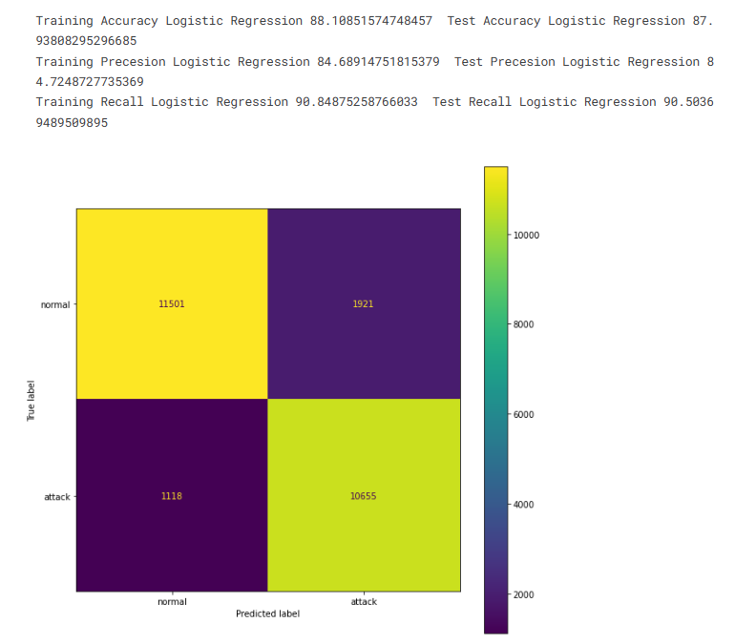
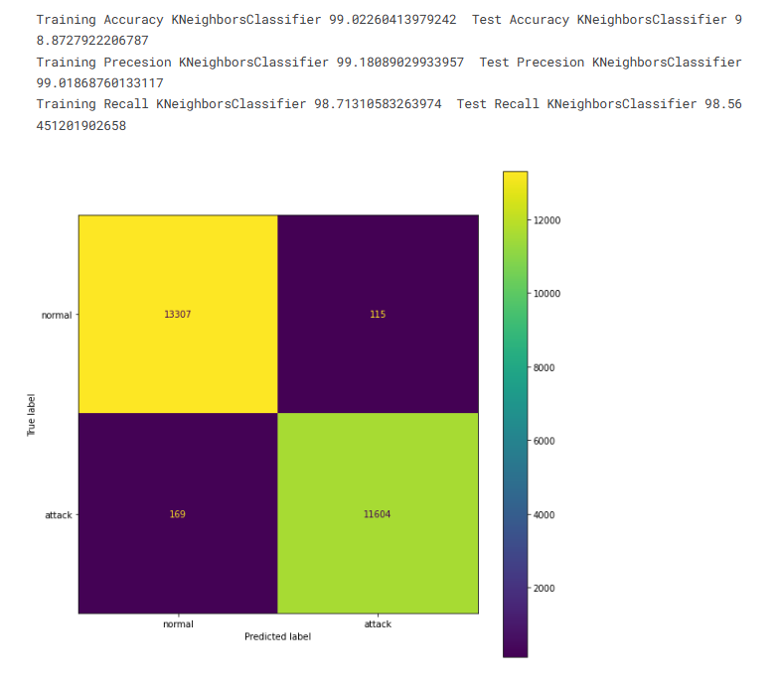
Model Evaluations (ML)
Logistic Regression
KNN

Slide 10
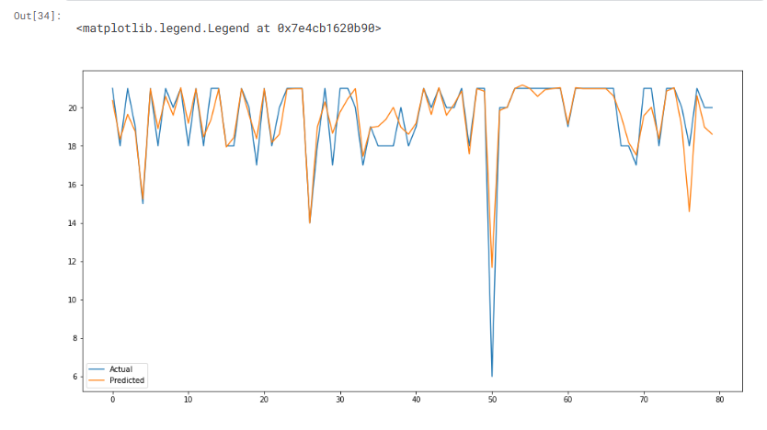
Model Evaluation (ML)
XGBoost Regressor

Slide 11
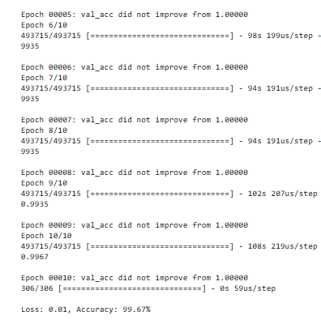
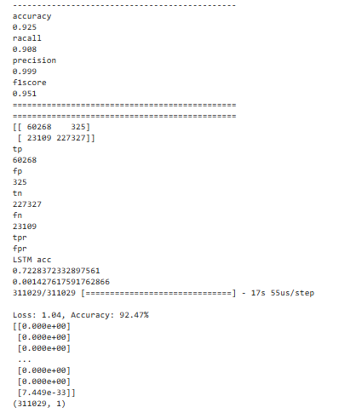
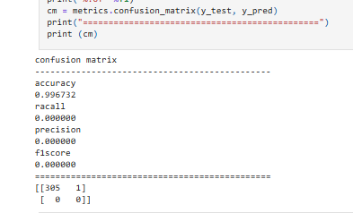
Model Evaluation (DL)
CNN-LSTM
LSTM
GRU

Slide 12


Facilities Required
Hardware
Requirements
System involving GPU for training model
Google Collab
AWS EC2
Software Requirements
Deep Learning
TensorFlow/Keras
xgboost
Python Libraries
Pandas
Scikit-learn
Seaborn
Matplotlib
Numpy

Slide 13


Thank You

